Slide 1

Chapter 23
Electronic Mail:
SMTP, POP
IMAP, and MIME
Copyright © The McGraw-Hill Companies, Inc. Permission required for reproduction or display.

Slide 2
OBJECTIVES:
To explain the architecture of electronic mail using four scenarios.
To explain the user agent (UA), services provided by it, and two types of user agents.
To explain the mechanism of sending and receiving e-mails.
To introduce the role of a message transfer agent and Simple Mail
Transfer Protocol (SMTP) as the formal protocol that handles MTA.
To explain e-mail transfer phases.
To discuss two message access agents (MAAs): POP and IMAP.

Slide 3
OBJECTIVES (continued):
To discuss MIME as a set of software functions that transforms non-ASCII data to ASCII data and vice versa.
To discuss the idea of Web-based e-mail.
To explain the security of the e-mail system.

Slide 4
Chapter
Outline
23.1 Architecture
23.2 User Agent
23.3 Message Transfer Agent
23.4 Message Access Agent
23.5 MIME
23.6 Web-Based Mail
23.7 Electronic Mail Security

Slide 5
23-1 ARCHITECTURE
To explain the architecture of e-mail, we give four scenarios. We begin with the simplest situation and add complexity as we proceed. The fourth scenario is the most common in the exchange of e-mail.

Slide 6
Topics Discussed in the Section
First Scenario
Second Scenario
Third Scenario
Fourth Scenario

Slide 7
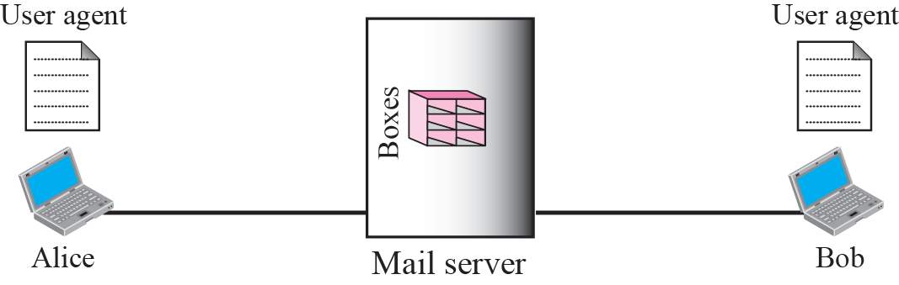

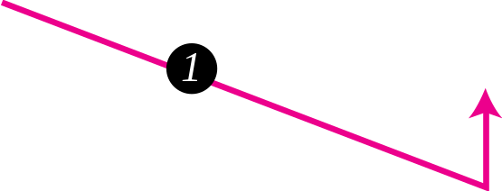
Figure 23.1 First scenario

Slide 8

Note
When the sender and the receiver of an e-mail are on the same mail server,
we need only two user agents.

Slide 9
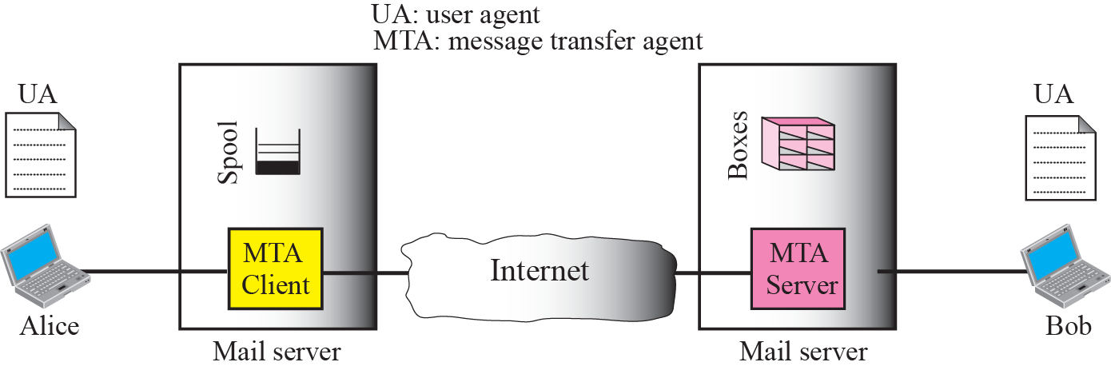
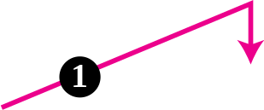
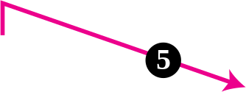



Figure 23.2 Second scenario

Slide 10
Note
When the sender and the receiver of an e-mail are on different mail servers,
we need two UAs and a pair of MTAs (client and server).

Slide 11
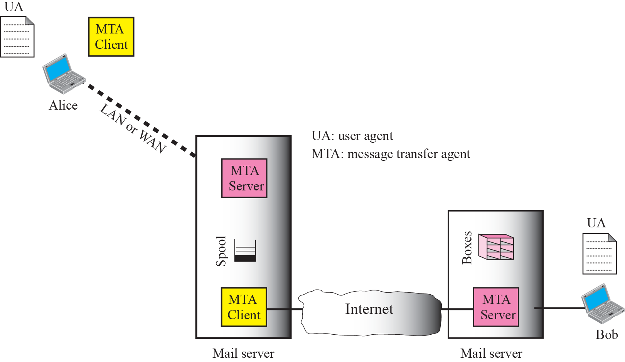

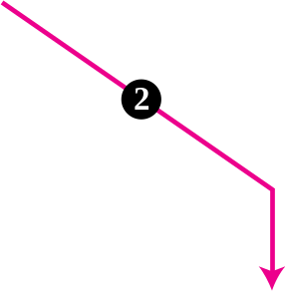





Figure 23.3 Third scenario

Slide 12
Note
When the sender is connected to the mail server via a LAN or a WAN, we
need two UAs and two pairs of MTAs
(client and server).

Slide 13
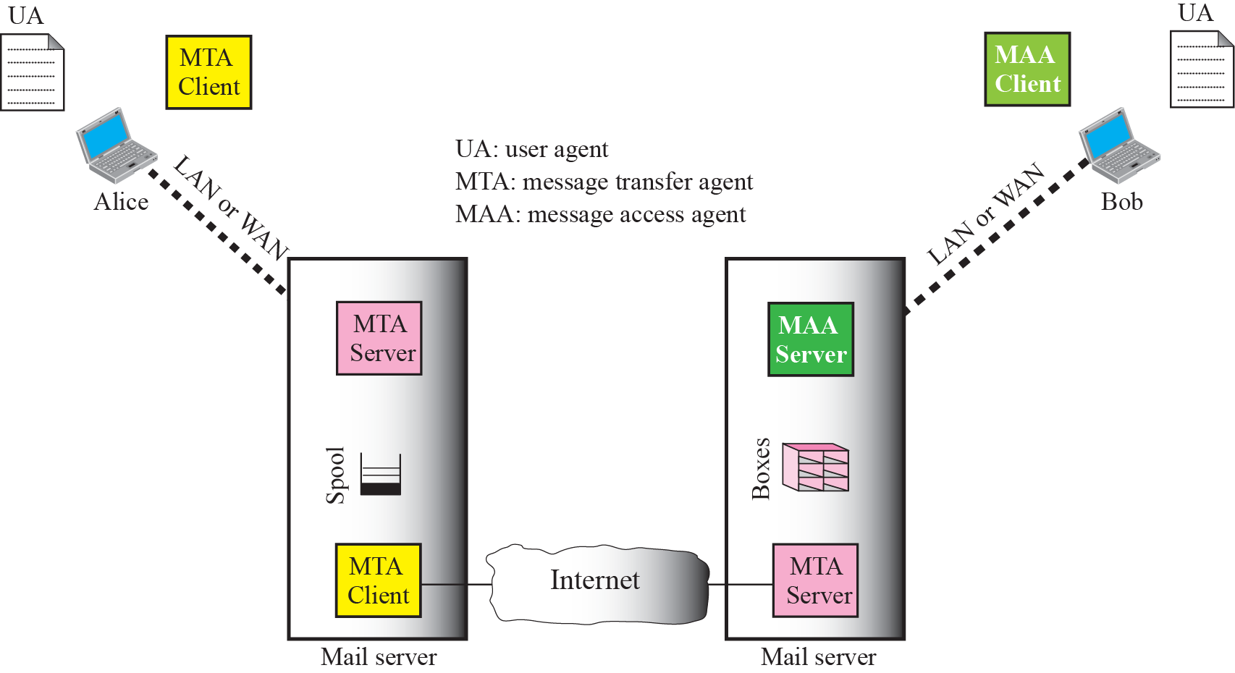

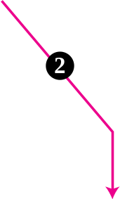

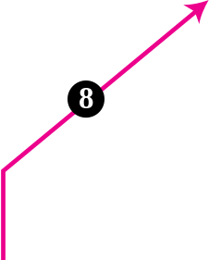





Figure 23.4 Fourth scenario

Slide 14
Note
When both sender and receiver are connected to the mail server via a LAN or a WAN, we need two UAs, two pairs of MTAs (client and server), and a pair of MAAs (client and server). This is the most common situation today.

Slide 15
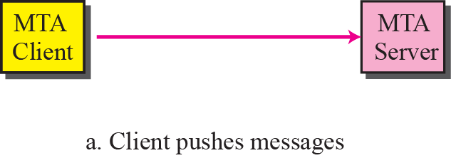
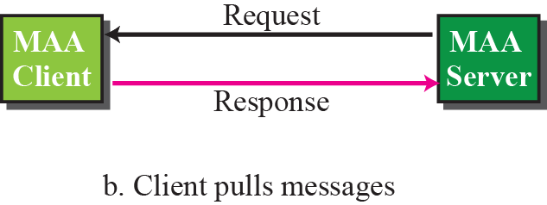
Figure 23.5 Push versus pull

Slide 16
23-2 USER AGENT
The first component of an electronic mail system is the user agent (UA). It provides service to the user to make the process of sending and receiving a message easier.

Slide 17
Topics Discussed in the Section
Services Provided by a User Agent
User Agent Types
Sending Mail
Receiving Mail
Addresses
Mailing List or Group List

Slide 18
Note
Some examples of command-driven user agents are mail, pine, and elm.

Slide 19
Note
Some examples of GUI-based user agents are Eudora, Outlook,
And Netscape.

Slide 20
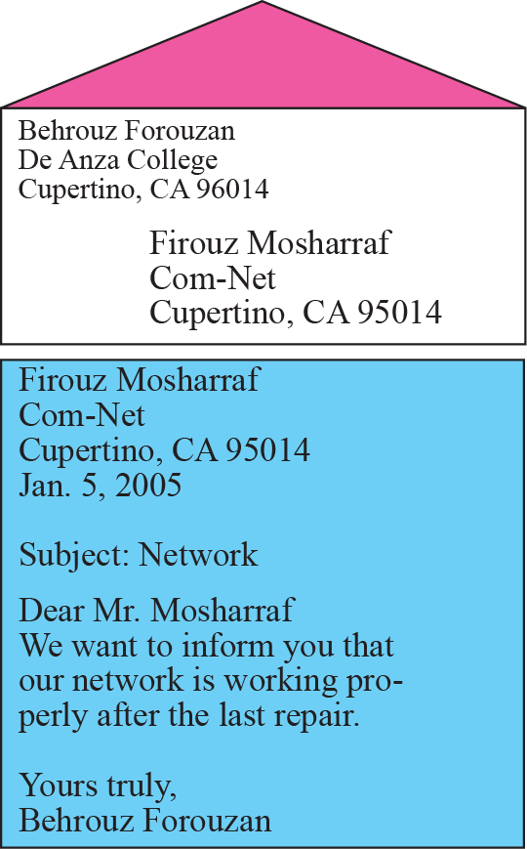
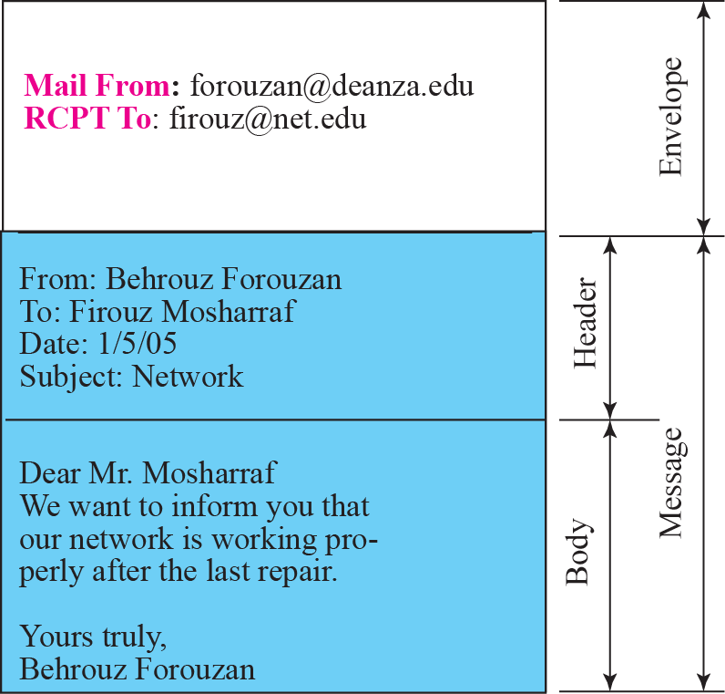
Figure 23.6 Format of an email

Slide 21
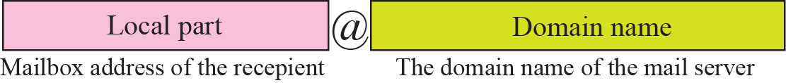
Figure 23.7 E-mail address

Slide 22
23-3 MESSAGE TRANSFER AGENT
The actual mail transfer is done through message transfer agents (MTAs). To send mail, a system must have the client MTA, and to receive mail, a system must have a server MTA. The formal protocol that defines the MTA client and server in the Internet is called Simple Mail Transfer Protocol (SMTP). As we said before, two pairs of MTA client-server programs are used in the most common situation (fourth scenario). Figure 23.8 shows the range of the SMTP protocol in this scenario.

Slide 23
Topics Discussed in the Section
Commands and Responses
Mail Transfer Phases

Slide 24
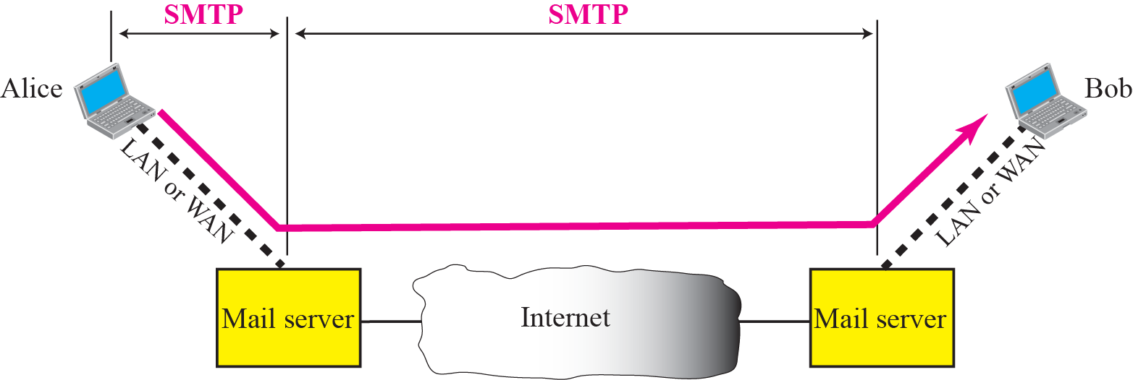
Figure 23.8 SMTP range

Slide 25
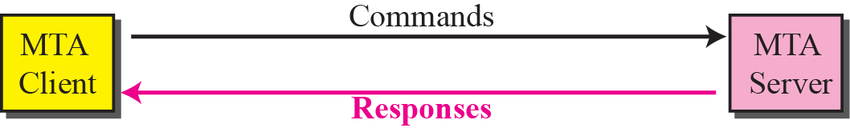
Figure 23.9 Commands and responses

Slide 26
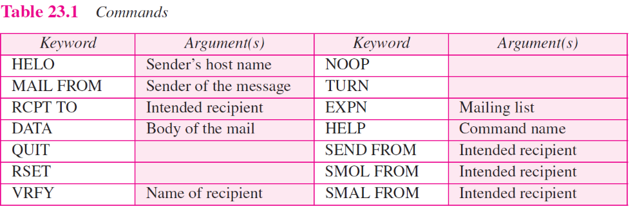

Slide 27
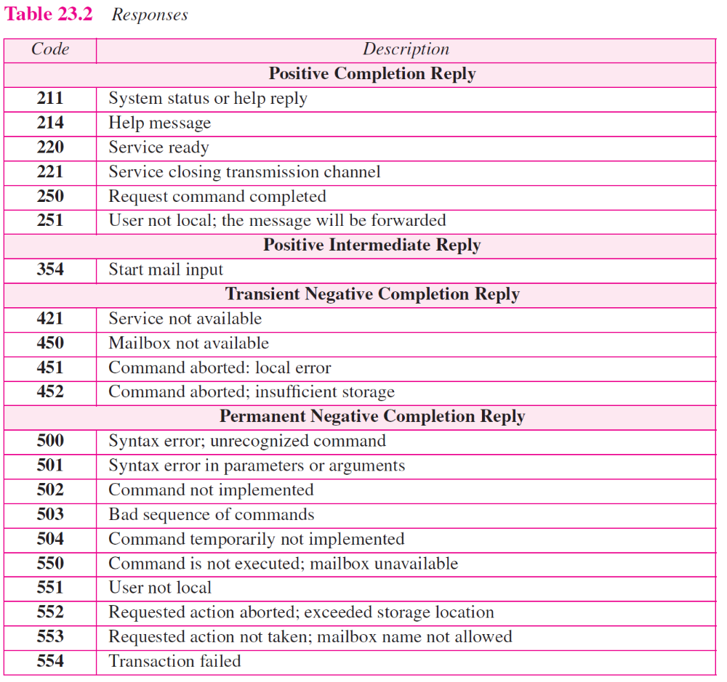

Slide 28
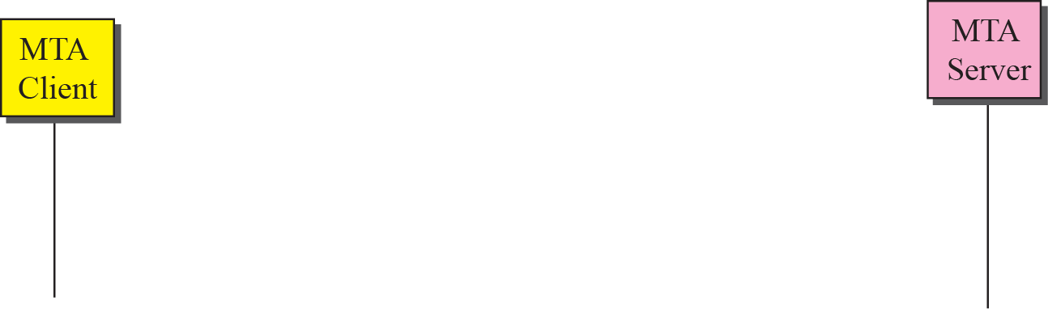
Figure 23.10 Connection establishment

Slide 29
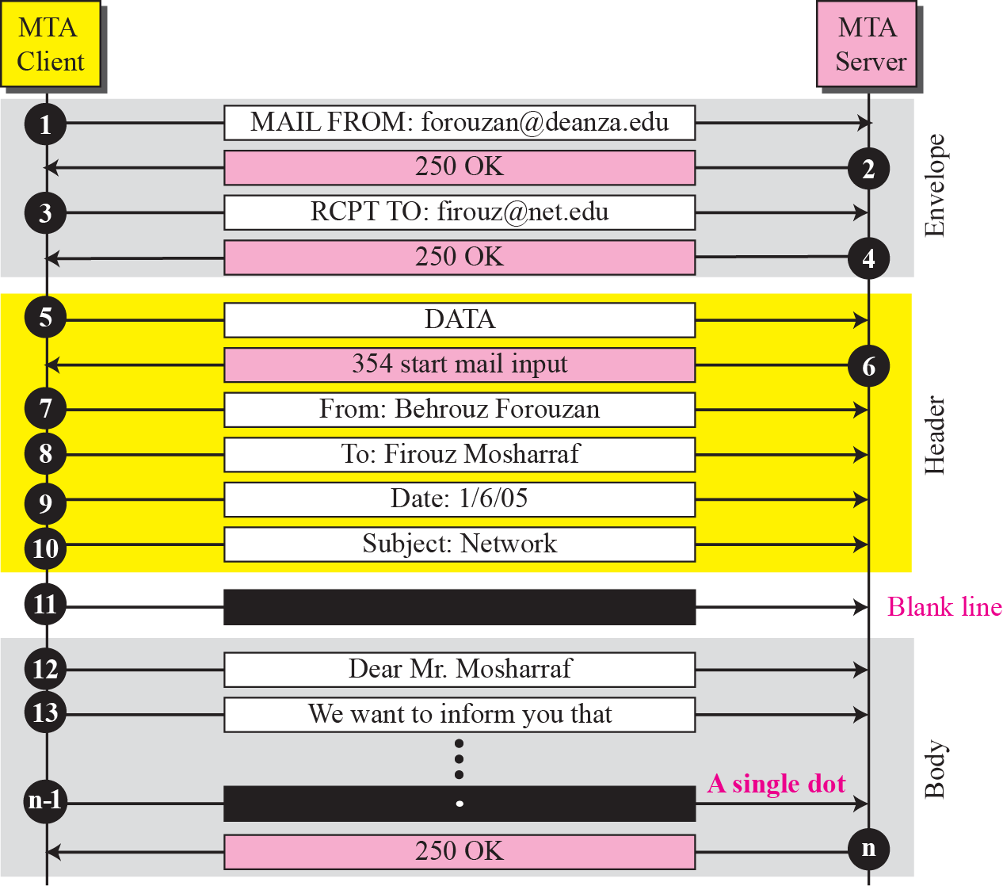
Figure 23.11 Message transfer

Slide 30
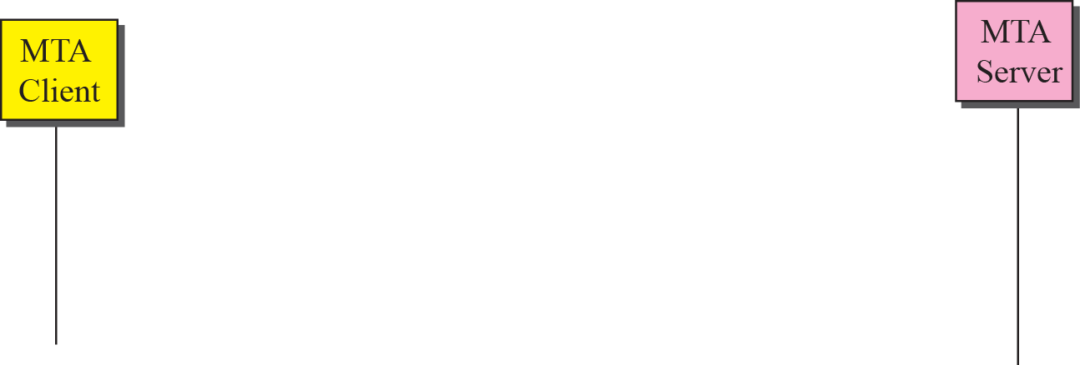
Figure 23.12 Connection termination

Slide 31
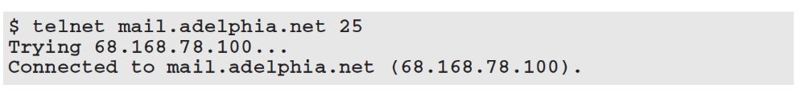
Example 23.1
Let us see how we can directly use SMTP to send an e-mail and simulate the commands and responses we described in this section. We use TELNET to log into port 25 (the well-known port for SMTP). We then use the commands directly to send an e-mail. In this example, forouzanb@adelphia.net is sending an e-mail to himself. The first few lines show TELNET trying to connect to the adelphia mail server.
After connection, we can type the SMTP commands and then receive the responses as shown below. We have shown the commands in black and the responses in color. Note that we have added for clarification some comment lines, designated by the “=” sign. These lines are not part of the e-mail procedure.

Slide 32
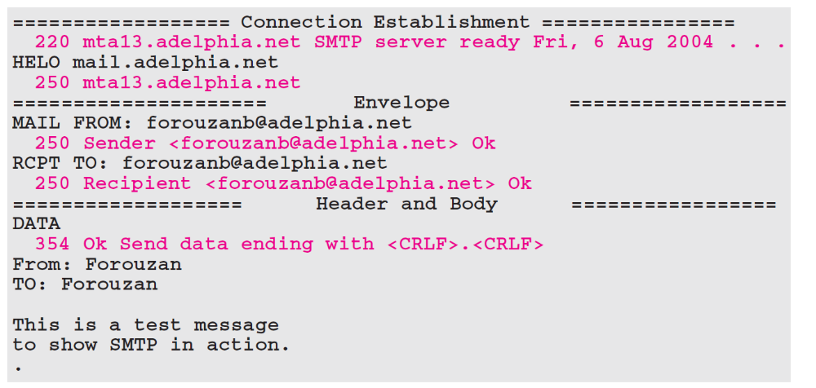
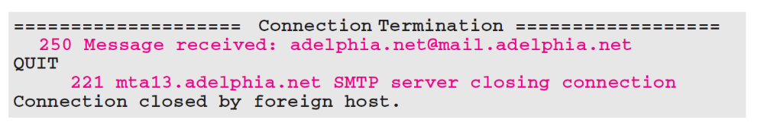
Example 19.1 Continued

Slide 33
23-4 MESSAGE ACCESS AGENT
The first and the second stages of mail delivery use SMTP. However, SMTP is not involved in the third stage because SMTP is a push protocol; it pushes the message from the client to the server. In other words, the direction of the bulk data (messages) is from the client to the server. On the other hand, the third stage needs a pull protocol; the client must pull messages from the server. The direction of the bulk data are from the server to the client. The third stage uses a message access agent.

Slide 34
Topics Discussed in the Section
POP3
IMAP4

Slide 35
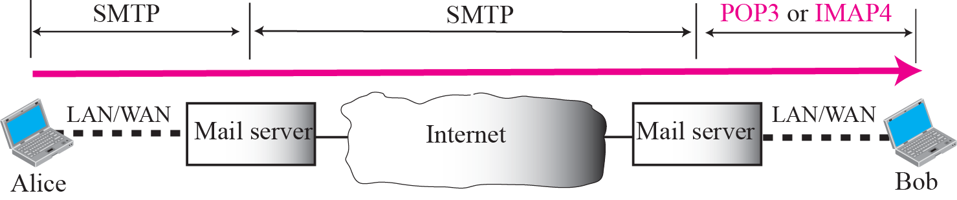
Figure 23.13 Pop3 and IMAP4

Slide 36
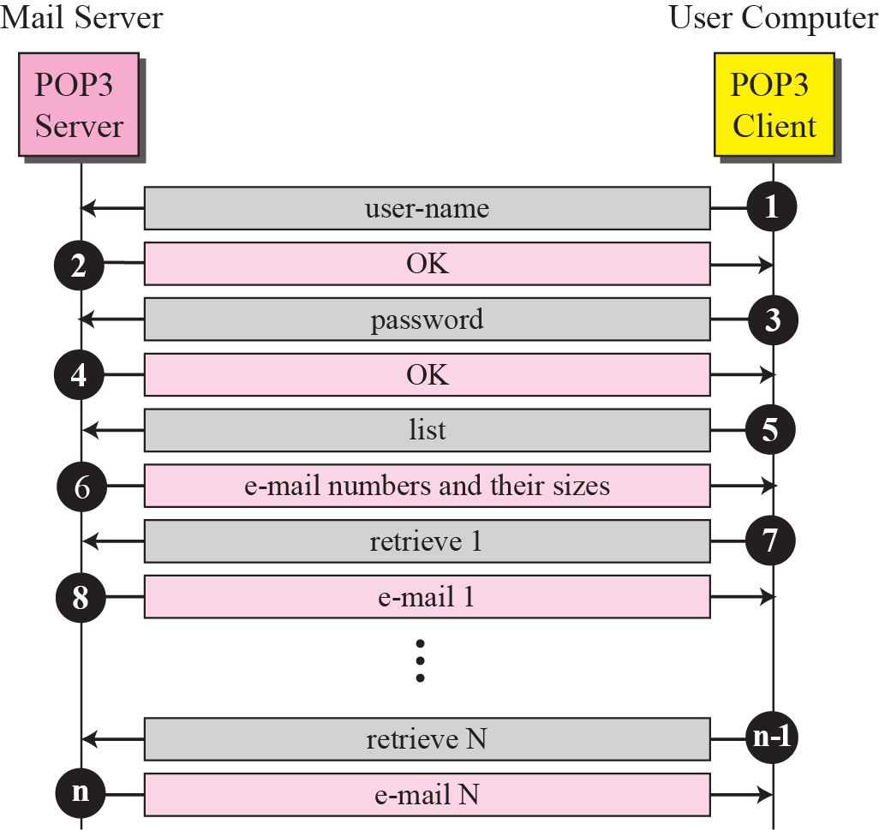
Figure 23.14 Pop3

Slide 37
23-5 MIME
Electronic mail has a simple structure. Its simplicity, however, comes with a price. It can send messages only in NVT 7-bit ASCII format. In other words, it has some limitations. Multipurpose Internet Mail Extensions (MIME) is a supplementary protocol that allows non-ASCII data to be sent through e-mail. MIME transforms non-ASCII data at the sender site to NVT ASCII data and delivers it to the client MTA to be sent through the Internet. The message at the receiving site is transformed back to the original data.

Slide 38
Topics Discussed in the Section
MIME Headers

Slide 39
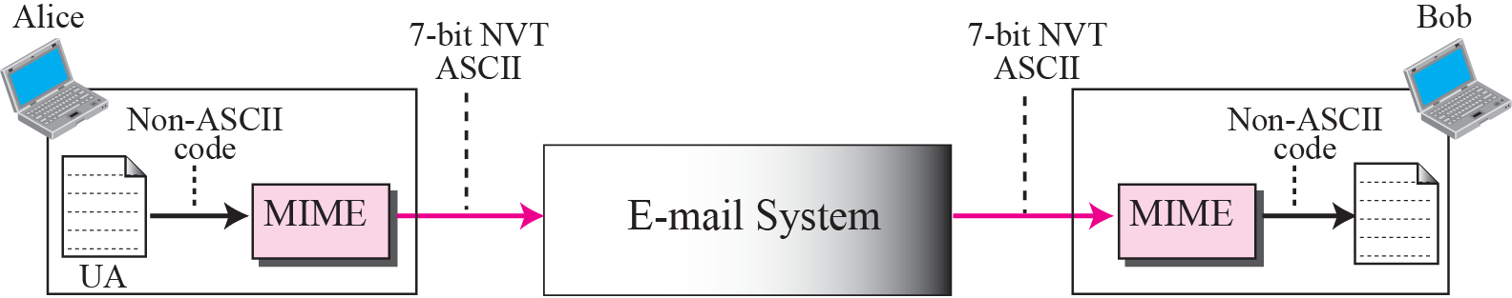
Figure 23.15 MIME

Slide 40
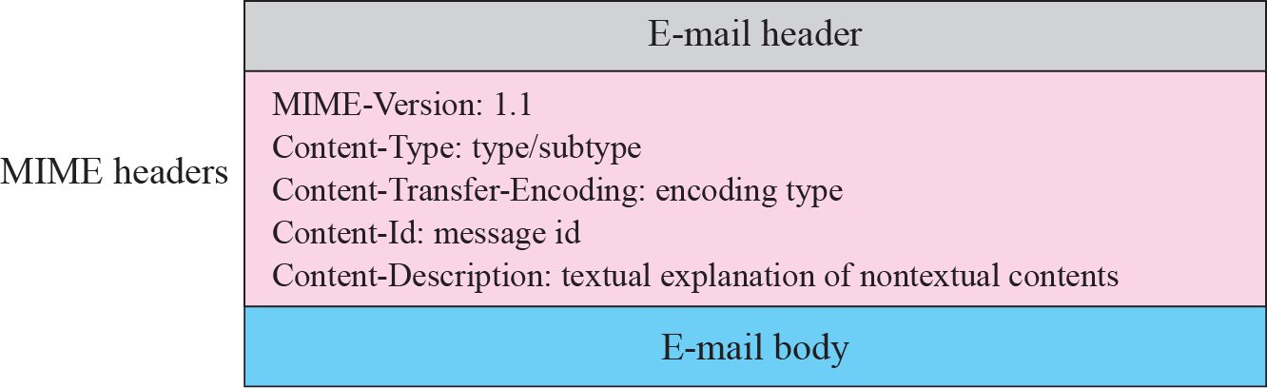
Figure 23.16 MIME header

Slide 41
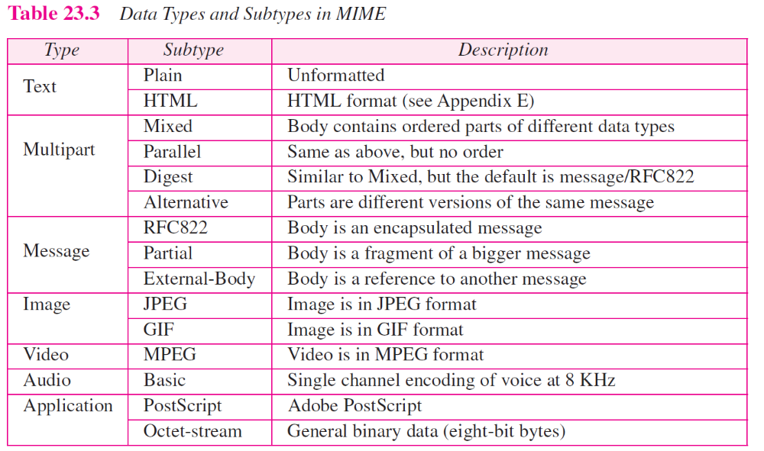

Slide 42
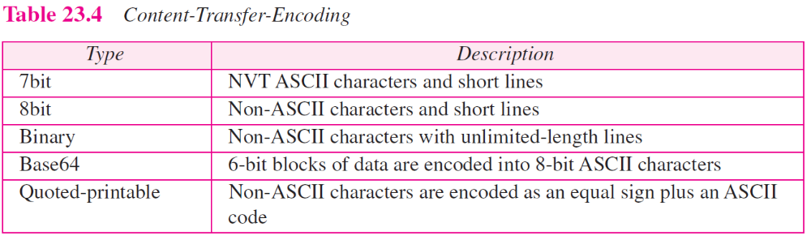

Slide 43
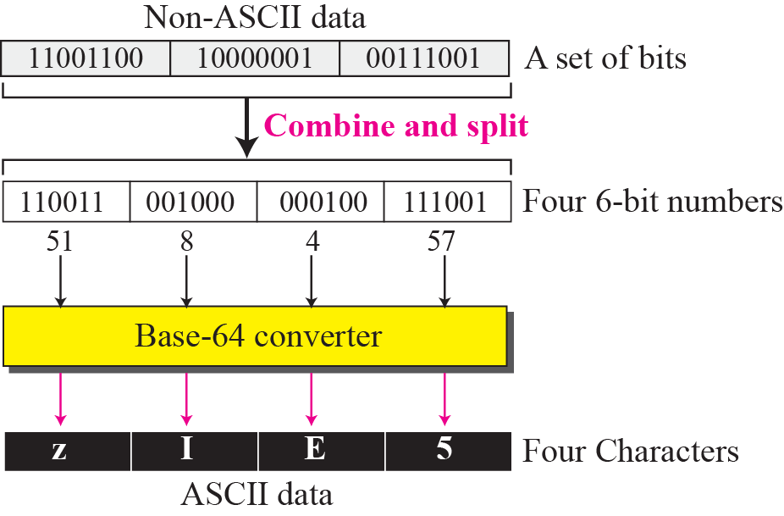
Figure 23.17 Base64

Slide 44
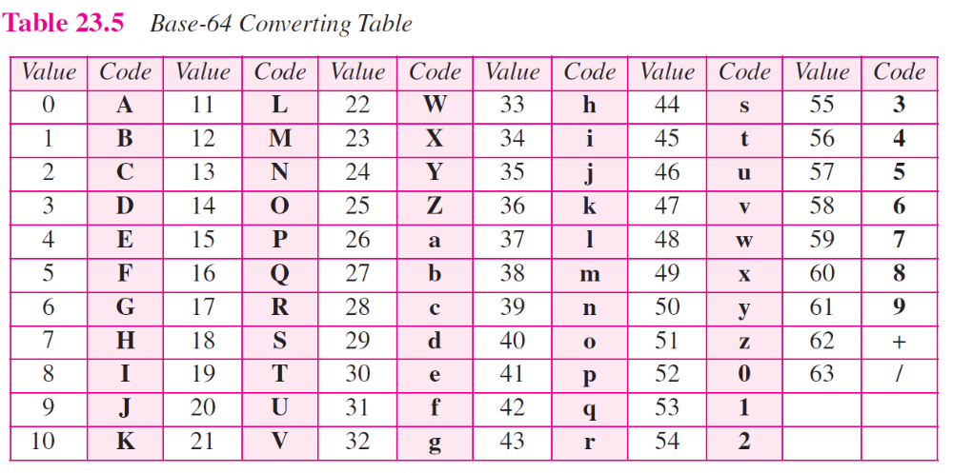

Slide 45
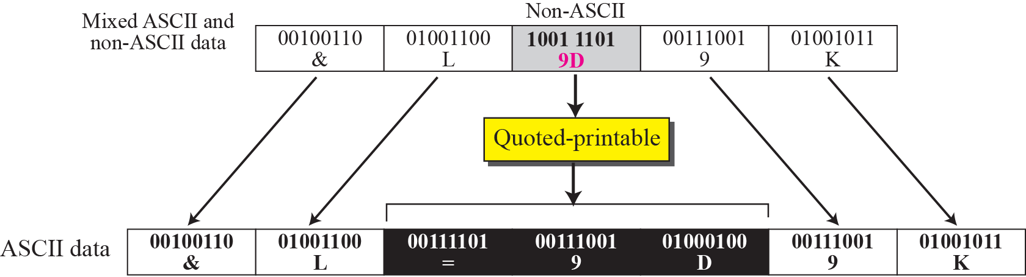
Figure 23.18 Quoted printable

Slide 46
23-6 WEB-BASED MAIL
E-mail is such a common application that some websites today provide this service to anyone who accesses the site. Three common sites are Hotmail, Yahoo, and Google. The idea is very simple. Let us go through two cases:

Slide 47
Topics Discussed in the Section
Case I
Case II

Slide 48
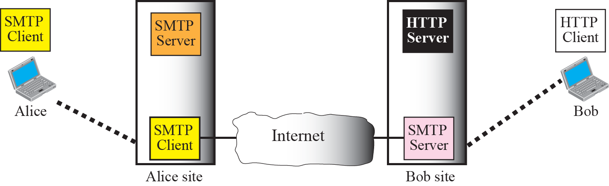

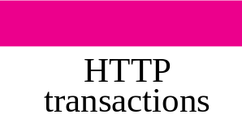



Figure 23.19 Web-based e-mail, case 1

Slide 49

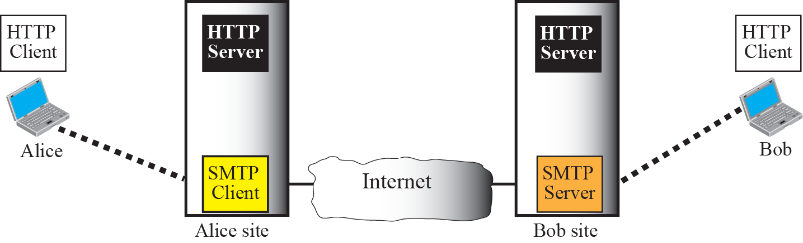



Figure 23.20 Web-based e-mail, case 2

Slide 50
23-6 E-MAIL SECURITY
The protocol discussed in this chapter does not provide any security provisions per se. However, e-mail exchanges can be secured using two application-layer securities designed in particular for e-mail systems. Two of these protocols, Pretty Good Privacy (PGP) and Secure MIME (SMIME) are discussed in Chapter 30 after we have discussed the basic network security.

